Slide 1

FY20 SHERM Metrics-Based
Performance Summary
Key Performance Indicators for Safety, Health, Environment & Risk Management (SHERM):
Losses, Compliance, Finances, and Client Satisfaction

Slide 2
UTHealth Institutional Missions and
SHERM’s Role, Contributions
UTHealth institutional missions:
  Teaching
  Research
  Service
    Service to the Institution (SHERM’s primary role)
      4 Key Performance Indicators (KPI) of safety services provided
    Service to the Community
SHERM also contributes to the other key institutional missions as well

Slide 3
COVID-19 Pandemic Impacts
Throughout this year’s annual report, impacts to our departmental operations and services due to COVID-19 are specifically highlighted and addressed
  Many services dramatically increased
  Normal operations and services were maintained
  Some services reduced or were deferred until a later time period
As essential personnel, SHERM staff remained on campus during the entirety of the pandemic to serve the institution
Despite the incredibly high work load, all SHERM staff participated in the mandatory “one day per week” vacation / furlough program for the full sixteen week period

Slide 4
Summary of COVID-19 Timeline and Events
Biosafety Program monitored outbreak situation starting in December 2019
Interim policies regarding travel restrictions and return to campus developed to address escalation of outbreak situation (in cooperation with Student and Employee Health)
Communications distributed to UTHealth campus
Very frequent Incident Command calls with UTHealth leadership
Signage posted throughout UTHealth buildings regarding basic public heath precautions
Social distancing, thermal scanning, travel history, health history implemented
School and workplace closures in alignment with Governor’s executive orders
Working and learning remotely considerations and issues
Issues regarding child coverage (closure of UTHealth child care center)
PPE shortages, sourcing issues, and establishment of PPE Task Force; N95 reprocessing center
Respiratory fit testing and training for over 4X normal volume of individuals
Adjusting SHERM workloads to accommodate for furlough days but maintaining regulatory compliance and service levels
Implementation of additional housekeeping disinfection and cleaning protocols
On site consultations for schools, departments, and units returning to campus
Training regarding PPE use, particularity for students interacting with patients during ongoing periods of widespread community transmission
Increase in IBC protocol submittals and reviews
…and much, much more…

Slide 5
SHERM’s Four Key Performance Indicators (KPI) for Safety Services to the Institution
KPI #1 Losses
Personnel
Property
KPI #2 Compliance
With external agencies
With internal assessments
KPI #3 Finances
Expenditures
Revenues
KPI #4 Client Satisfaction
External clients served
Internal department staff

Slide 6
KPI #1: Losses
Personnel
  Numbers of first reports of injury submitted by employees, residents, students
  Number of reported employee injuries and illnesses requiring medical treatment
  Workers’ Compensation Insurance experience modifier
Property
  Losses incurred and covered by UTS Comprehensive Property Protection Program
  Losses incurred but covered by outside party
  Losses retained by UTHealth

Slide 8
Total Number of Employee First Reports of Injury and Subset of Compensable Claims
Submitted to UT System, FY03 to FY20
Medical Residents transitioned
to become Employees
Oversight by SHERM
Number of reports with no medical claims
Number of reports with medical claims
*Increase in UTP clinics has resulted in greater risk of injury due to higher clinical injury exposures

Slide 9
Annual UTHealth Incidence Rate of Reported Employee Injuries and Illnesses
Compared to National Hospital and University Rates
(national data source: US Bureau of Labor Statistics)
Annual Reported Injury/Illness Rates
Hospitals
NAICS 622
Universities
NAICS 6113
UTHealth

Slide 10
Workers’ Compensation Insurance Premium Experience Modifier for
UT System Health Institutions Fiscal Years 03 to 20
(premium rating based on a three year rolling average as compared to a baseline of 1.00)
Medical Residents transitioned
to become Employees
Oversight by SHERM
UTHSCT (0.193)
UTMB (0.122)
UTHSCSA (0.100)
UTSWMCD (.091)
UTHSCH (.073)
UTMDACC (0.043)
Fiscal Year

Slide 11
FY20 Retained Property Losses
Retained Losses (inclusive of insurance deductibles)
Losses incurred and covered by third party
  Auto-------------11/2019 $3,179
  Auto --------------3/2020 $1,287
  Auto--------------4/2020 $7,630
  Auto--------------4/2020 $5,991
  Auto--------------4/2020 $2,473
Losses incurred and covered by UTS insurance
  N/A
Retained Loss Cost Summary by Peril
(Total FY20 retained losses = $10,100)
Type | Location | Date | Cost
Water | Housing | 9/2019 | $1,000
Water | Housing | 9/2019 | $250
Water | Housing | 9/2019 | $1,000
T.S. Imelda | Various | 9/2019 | $1,000
Water | SPH | 12/2019 | $200
Water | UCT | 1/2020 | $1,000
Water | UCT | 3/2020 | $2,000
Fire | Housing | 6/2020 | $150
Misc. | Misc. | ------ | $3,500
TOTAL |  |  | $10,100
Auto
Fire

Slide 12
UTHealth Total Property Retained Loss Summary by Peril and Value, FY06 to FY20
NOTE: FY17 & FY18 does not include Harvey losses – data not yet available
Lightning/Fire*
Hurricane
Water
*Lightning strike caused fire damage at student housing totaling $978,000 loss

Slide 13
COVID-19 Impacts on Losses
Employees, residents, and students testing positive during COVID-19 pandemic impacting their ability to work or learn
  Each case resulted in needs for contact investigations, disinfection/decontamination of work spaces, and lost work time during quarantine period
34 individuals providing clinical care submitted First Reports of Injuries indicating they sustained a workplace COVID-19 exposure
Total number of First Reports of Injury plummeted overall during fiscal year due to significant number of individuals working or learning remotely
Anticipating possible increase in First Reports of Injury for issues sustained off campus while working/learning remotely (e.g. ergonomics, etc.), but this has not occurred yet

Slide 14
FY21 Planned Actions - Losses
Personnel
  Closely monitor increase in reported employee injury events (largely from the clinic setting) determine root cause and implement preventive measures
  Evaluate slip, trip, and fall data to determine possible trends or locations; provide interventions to prevent recurrence where possible
  Continue to focus on transition of medical residents who became employees on July 1, 2019 to contain costs associated with bloodborne pathogens exposures
  Continue to support individuals as they “return to campus” during the COVID-19 pandemic situation to ensure health and safety of all campus stakeholders
Property
  Continue with successful efforts to educate faculty and staff about common perils causing losses (water, power interruption, and theft), simple interventions
  Develop additional predictive methods for prompt recovery after losses occur, specifically estimated length of time to recovery
  Continue to refine and improve oversight of UTP property loss prevention, mitigation, and insurance program

Slide 15
KPI #2: Compliance
With external agencies
  Regulatory inspections; other compliance related inspections by outside entities
With internal assessments
  Results of EH&S routine safety surveillance activities

Slide 16
External Agencies Inspections n= 24
 | Date | Agency | Findings | Status
1 | September 3, 2019 | Texas Department of State Health Services Radiation Control | No items of non-compliance (UTHealth, Dental Surgeons at Scurlock, X-ray R10908, Site 027, Unannounced) | Inspection file closed
2 | November 18, 2019 | Texas Department of State Health Services Radiation Control | No items of non-compliance (UT Physicians, Fall Creek Ortho clinic, X-ray R26367, Site 038, Unannounced) | Inspection file closed
3 | December 5, 2019 | Texas Department of State Health Services Radiation Control | No items on non-compliance (UT Physicians, RBJ Sugarland Ortho clinic, X-ray R26367, site 022, Unannounced) | Inspection file closed
4 | December 20, 2019 | Texas Department of State Health Services Radiation Control | EPE alleged late, requested rescind due to miscalculation by inspector (UT Physicians, SE Astoria Ortho clinic, X-ray R26367, site 009, Unannounced) | Inspection file closed
5 | January 30, 2020 | Texas Department of State Health Services Radiation Control | No items on non-compliance (UT Physicians, Cypress Ortho, X-ray R26367, Site 035, Unannounced) | Inspection file closed

Slide 17
External Agencies Inspections n= 24
 | Date | Agency | Findings | Status
6 | January 30, 2020 | Texas Department of State Health Services Radiation Control | No items of non-compliance (UT Physicians, Bayshore Multispecialty clinic, Radioactive License L05465, site 004) | Inspection file closed
7 | February 26, 2020 | Texas Department of State Health Services Radiation Control | Inadequate QA/QC procedures (UTHealth, Dental GPR at UTPB Suite 300, X-ray R10908, Site 016, Unannounced) | Inspection file closed
8 | April 27- May 1, 2020 | Centers for Disease Control and Prevention, Federal Select Agent Program (conducted virtually due to COVID-19) | Several minor findings and recommendations for improvement | All findings addressed and corrected; inspection file closed
9 | May 18, 2020 | Texas Department of State Health Services Radiation Control | No items of non-compliance (UT Physicians, Katy Ortho clinic, X-ray R26367, Site 000, Virtual during COVID-19 precautions) | Inspection file closed
10 | May 18, 2020 | Texas Department of State Health Services Radiation Control | No items of non-compliance (UT Physicians, Bellaire MIST clinic, X-ray R26367, Site 007, Virtual during COVID-19 precautions) | Inspection file closed

Slide 18
External Agencies Inspections n= 24
 | Date | Agency | Findings | Status
12 | May 18, 2020 | Texas Department of State Health Services Radiation Control | No items of non-compliance (UT Physicians, SW Ortho (Jones) clinic, X-ray R26367, Site 012, Virtual during COVID-19 precautions) | Inspection file closed
13 | May 19, 2020 | Texas Department of State Health Services Radiation Control | No items of non-compliance (UT Physicians, Memorial City Ironman clinic, X-ray R26367, Site 013, Virtual during COVID-19 precautions) | Inspection file closed
14 | May 19, 2020 | Texas Department of State Health Services Radiation Control | No items of non-compliance (UT Physicians, Memorial Westside Bone & Joint clinic, X-ray R26367, Site 017, Virtual during COVID-19 precautions) | Inspection file closed
15 | May 19, 2020 | Texas Department of State Health Services Radiation Control | No items of non-compliance (UT Physicians, Cinco Ranch clinic, X-ray R26367, Site 015, Virtual during COVID-19 precautions) | Inspection file closed
16 | May 19, 2020 | Texas Department of State Health Services Radiation Control | No items of non-compliance (UT Physicians, Woodlands Ortho clinic, X-ray R26367, Site 020, Virtual during COVID-19 precautions) | Inspection file closed

Slide 19
External Agencies Inspections n= 24
 | Date | Agency | Findings | Status
17 | May 19, 2020 | Texas Department of State Health Services Radiation Control | No items of non-compliance (UT Physicians, Bay Area Pedi clinic, X-ray R26367, Site 026, Virtual during COVID-19 precautions) | Inspection file closed
18 | May 19, 2020 | Texas Department of State Health Services Radiation Control | No items of non-compliance (UT Physicians, HOSP Bellaire clinic, X-ray R26367, Site 028, Virtual during COVID-19 precautions) | Inspection file closed
19 | May 19, 2020 | Texas Department of State Health Services Radiation Control | No items of non-compliance (UT Physicians, Neuroscience Spine clinic, X-ray R26367, Site 040, Virtual during COVID-19 precautions) | Inspection file closed
20 | May 27, 2020 | Texas Department of State Health Services Radiation Control | No items of non-compliance (UT Physicians, Pearland Ortho 2 clinic, X-ray R26367, Site 041, Virtual during COVID-19 precautions) | Inspection file closed
21 | May 27, 2020 | Texas Department of State Health Services Radiation Control | No items of non-compliance (UT Physicians, TMC Ortho clinic at Suite 2250, X-ray R26367, Site 030, Virtual during COVID-19 precautions) | Inspection file closed

Slide 20
External Agencies Inspections n= 24
 | Date | Agency | Findings | Status
22 | May 27, 2020 | Texas Department of State Health Services Radiation Control | No items of non-compliance (UT Physicians, Pearland Ortho clinic, X-ray R26367, Site 029, Virtual during COVID-19 precautions) | Inspection file closed
23 | May 27, 2020 | Texas Department of State Health Services Radiation Control | No items of non-compliance (UT Physicians, Sugarland ortho clinic, X-ray R26367, Site 011, Virtual during COVID-19 precautions) | Inspection file closed
24 | August 11, 2020 | Texas Department of State Health Services Radiation Control | No items of non-compliance (UTHealth, Broad license on South Campus (BBSB, SCRB3 and SOD) Radioactive material license L02774, Site 007, in person inspection with different clinical & research COVID-19 precautions and procedures) | Inspection file closed

Slide 21
Non-Routine External Compliance
Ensuring “normal” compliance measures remained in place during COVID-19 shutdown and ongoing pandemic situation
Adjusting operations to meet regulatory compliance variances issued by various regulatory authorities during COVID-19 shutdowns (e.g. oversight of radioactive materials; respiratory protection requirements due to severe global supply shortages such as reuse or reprocessing of protective equipment and temporary exemption from annual fit testing requirements; etc.)
Adaptation to new “virtual” format utilized for regulatory inspections in lieu of onsite inspections during the COVID-19 pandemic

Slide 22
Routine Internal Compliance Assessments
4,358 workplace assessments documented (decrease of 30% compared to FY19 due to COVID-19 impacts)
  Progression of routine surveillance program emphasis: labs, clinics, building fire systems, mechanical and non-lab spaces
  1,316 deficiencies identified (70% in non-lab spaces)
      390 of these deficiencies now corrected to date (represents a decreased efficiency in correcting deficiencies due to challenges of COVID-19 impacts)
      EHS will continue to focus on assisting with correction of remaining 926 deficiencies
        Some lab personnel not present onsite to help correct local issues
        Clinical staff focused on COVID-19 issues and patient care as a priority
      Working with FPE to track and report progress and reporting progress to appropriate safety committees
  12,641 individuals provided with required safety training (increase of 49% due to COVID-19 impacts)
      Increase from 1,200-1,300 individuals on average per year to 5,500 individuals trained and fit tested for respiratory protection
      Clinical based students (e.g. McGovern Medical School, Cizik School of Nursing, School of Dentistry) provided with COVID-19 awareness and PPE training
      Drastic increase in participation in online safety training modules (primarily refresher lab and clinic safety training)
      Students accessing online safety training content in lieu of in-person training
      As a result of software upgrades, there is now improved reporting of online safety training between EHS Assistant and HR Learning Management System (Learn 2 Succeed)
  70% of PIs have submitted chemical inventories for filing in SHERM database

Slide 23
Non-Routine Internal Compliance
Onboarding of medical residents as employees which included termination of Texas Mutual WCI coverage and switching to UT System WCI oversight
Water quality testing conducted in all UTHealth building locations following City of Houston water boil event due to major water main break to ensure safety of water supply (February 2020)
Safety oversight of TRB major construction projects at UCT, MSB, and SPH; plus oversight of JJL renovations, new C3 project, and future TMC3 project

Slide 24
Non-Routine Internal Compliance
COVID-19 related challenges:
  Respiratory protection program compliance due to COVID-19 pandemic and the resulting severe global supply shortages
    Over 5,500 individuals fit tested and trained by SHERM during FY20 (under normal circumstances average is 1,200 – 1,300 individuals)
    Waiver of annual fit testing requirement per OSHA allowance – how do we maintain annual compliance for over 4X the normal average number of individuals going forward once this waiver is lifted?
    Expedited medical evaluations to ensure fit testing – resources needed for Employee Health and Student Health to maintain this service going forward
    Limited reuse and extended use of PPE per CDC guidelines
    Validation and oversight of decontamination of N95s at MHH reprocessing center
    Sourcing and vetting of PPE from traditional and non-traditional vendors
  Return to campus on-site consultations for academic, research, and clinical settings to ensure congruency with COVID-19 protocols to ensure health and safety of all occupants
  Conducting routine fire drills while buildings primarily unoccupied
  Completing required tests and documentation for radioactive materials

Slide 25
FY21 Planned Actions - Compliance
External compliance
  Continue to educate and prepare UTHealth & UTPhysicians clinics about State of Texas Radiation Control program who continue to conduct frequent unannounced x-ray inspections
  Consider participation in NNSA program to support decommissioning of Cesium irradiators and replacement with suitable X-ray irradiator alternatives
  Provide support for the forthcoming AAALAC accreditation site visit regarding occupational health and safety programs
  Providing necessary information and consultation for forthcoming SACSCOC site visit
Internal compliance
  Develop efficiencies and strategy for long term management of respiratory protection program now that the demand has increased over four fold due to COVID-19
  Continue aggressive routine surveillance program. Incorporate lessons learned from deficiency data into safety training to prevent recurrence.
  Focus on education of research and clinic personnel regarding controlled substances used and stored at UTHealth and UTP
  Continue to work with FPE to systematically address identified deficiencies and support current projects to address fire safety considerations
    Provide regular updates to appropriate safety committees
  Continue emphasis on lab inventories of hazardous materials
    Chemical inventories already a requirement
    Support biosafety awareness and inventory of biological agents and toxins within UTHealth laboratories

Slide 26
KPI #3: Finances
Expenditures
  Program cost, cost drivers
Revenues
  Sources of revenue, amounts

Slide 27
Campus Square Footage, SHERM Resource Needs and Funding
(modeling not inclusive of resources provided for, or necessary for Employee Health Clinical Services Agreement)
Total Assignable Square Footage
and Research Subset
Modeled SHERM Resource Needs and Institutional Allocations
Research area (sf)
Amount Not Funded
Contracts & Training
WCI RAP Rebate
Institutional Allocation
Non-research area (sf)
Source: FPE, Space Management
Note: TNASF reported in FY18 & FY19 reduced due to accounting adjustment by FPE

Slide 28
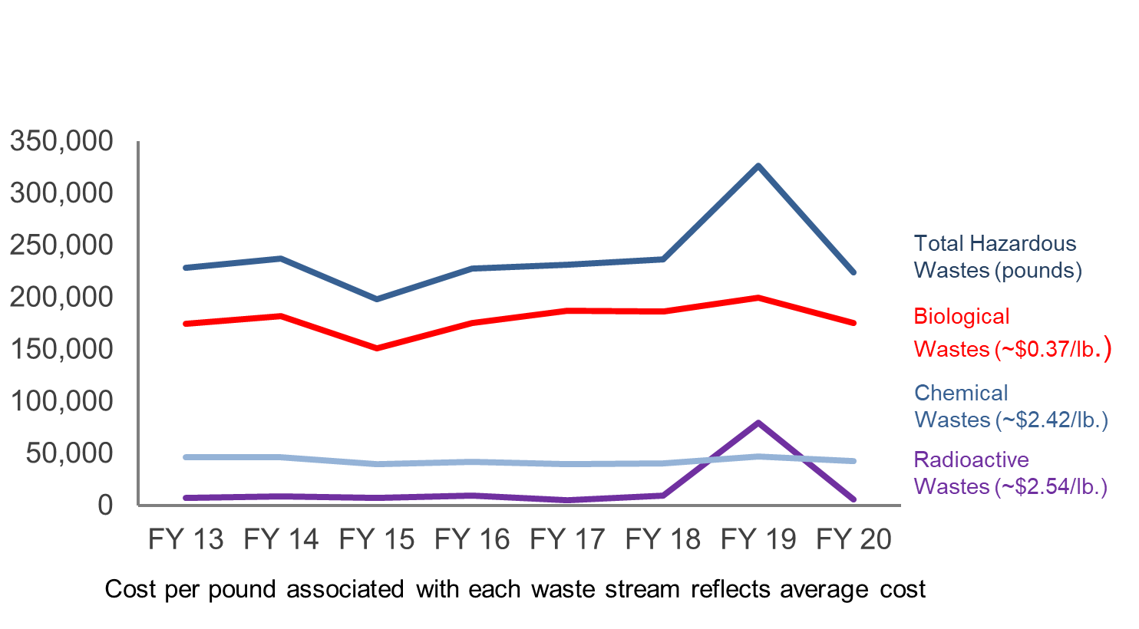
Annual Hazardous Wastes Volumes Generated (in pounds)
(inclusive of all Hazardous Biological, Chemical, and Radioactive Waste Streams)
Pounds
*Note: Increase in radioactive wastes in FY19 related to compulsory decommissioning of cyclotron unit

Slide 29
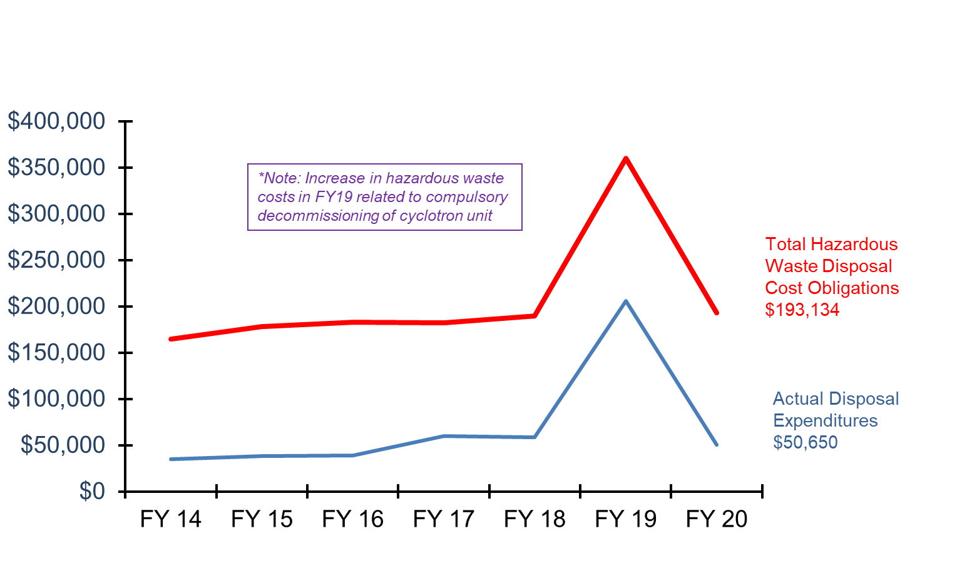
Hazardous Waste Cost Obligation and Actual Disposal Expenditures
(Inclusive of Biological, Chemical, and Radioactive Wastes)
FY20 savings: $142,484

Slide 30
FY20 Revenues
Service contracts
  UT Physicians $433,039
  Note: UT Med Foundation WCI Administration discontinued due to transition of medical residents
Continuing education courses/outreach
  Training, honoraria, peer reviews, $9,754
  and fit testing for non-UTHealth personnel
SHERM staff salary offsets from various research grants $30,000
Total $472,793
NOTE: Above equates to 18% of total SHERM budget for FY20

Slide 31
UT Physicians Service Agreement
Professional Services Agreement:
  Agreement includes services such as training, radiation safety permitting & surveys, general clinic surveys, fire & life safety surveillance, waste management, emergency preparedness & response, IAQ evaluations, asbestos/mold monitoring, accident/incident investigations, CAP/CLIA quality control monitoring, etc.
  5-year contract renewal due in April 2020, but extended to August 31, 2020 (at current annual rate of $427,693) to allow for transition to UTHealth / UTPhysicians MOU on Sept 1, 2020
  Separate contract to oversee UTP property insurance programs also extended until August 31, 2020 until it could be folded in with UTHealth / UTPhysicians MOU
Challenges
  Continued growth and rapid expansion of clinical locations and services
  Dramatic increase in manpower requirements for CAP/CLIA oversight and compliance, waste collection, occupational health services, training, etc.
  Emergency management for UTP clinics in different geographic locations

Slide 32
UT Physicians Service Agreement
UTHealth / UTPhysicians MOU
  Discontinued SHERM Professional Services Agreement and transitioned to UTHealth / UTPhysicians MOU at the request of UTHealth leadership on Sept 1, 2020
  Combination of safety, insurance, and occupational health services under one contract
  Current rate is now $800,000 annually for all services combined
Future Growth
  1 FTE planned for Hospital & Clinic Safety Program to primarily assist with CAP/CLIA oversight and compliance, respiratory fit testing for clinicians, etc.
  1 FTE planned for Risk Management & Insurance Program to primarily assist with additional responsibilities related to loss prevention and insurance oversight for UTP, as well as to bolster emergency preparedness and management

Slide 33
Safety Support to UTHealth / UTPhysicians Clinics
UTPhysicians Clinics:
  UTP clinic locations (n=118)
    Note: 12 pending new locations for FY21
  UTP timeshare locations (currently ~30)
UTHealth Clinics:
  UT Health Services Clinic (Employees and Medical Residents)
  UT Student Health Services Clinic
  SOD dental clinics (n=6)
  Neurosciences (n=11)
  WIC clinics (n=6)

Slide 34
FY21 Planned Actions - Financial
Expenditures
  Continue aggressive hazardous waste minimization program to contain hazardous waste disposal costs
  Focus on regulated medical waste generation reduction in labs and clinics due to 30% increase experienced during recent (Sept 1, 2019) renewal of UT System-wide contract
    Fees increase significantly each fiscal year for each point of collection, so primary focus is on minimizing volumes and maximizing efficiency to reduce stop frequencies
  Continue to lobby for dedicated funding for Occupational Health Clinical Services Agreement because of impending discontinuance of UTS WCI RAP
Revenues
  UTHealth / UTPhysicians MOU now includes occupational health allocation of $138,700
  Continue with service contracts and community outreach activities that provide financial support to supplement institutional funding, including enhancing virtual training capabilities
  Continue to participate in various research grant projects which allow for staff salary offsets
  Continued receipt of WCI RAP fund allocations in FY21 ($160,721), but program may terminate at any point

Slide 35
FY21 Challenges - Financial
Current Financial Challenges
  Continued support for 5,500 individuals now enrolled in respiratory protection program due to COVID-19
    Fit testing and training; sourcing of N95s and other PPE appropriate to protect workers and students from COVID-19 exposure
  Anticipate significant increase in retained loss medical expenses due to transition of UT Medical Foundation residents to UT System workers compensation policy upon becoming UTHealth employees
  Additional manpower needs, primarily in OSFP (to support JJL and C3 projects, as well as forthcoming TMC3 project) and Hospital and Clinic Safety (to support ongoing clinical growth)
  Potential additional FTE in FY21 to serve C3 once completed
  Current shortfall in funding for Occupational Health Program
    $450,000 currently necessary to run program, increases anticipated due to recent medical resident transition
    WCI RAP funds being used to support program, but these funds may not be issued again in future
    $138,700 now coming from UTHealth / UTPhysicians MOU to help support Occupational Health Program

Slide 36
KPI #4: Client Satisfaction
External clients served
  Results of Client Satisfaction Survey for UT Police department
Internal department staff
  Summary of ongoing staff professional development activities

Slide 37
Client Feedback
Focused assessment of a designated program aspect performed annually:
  FY03 – Clients of Radiation Safety Program
  FY04 – Overall Client Expectations and Fulfillment of Expectations
  FY05 – Clients of Chemical Safety Program Services
  FY06 – Clients of SHERM Administrative Support Staff Services
  FY07 – Feedback from Employees and Supervisors Reporting Injuries
  FY08 – Clients of Environmental Protection Program Services
  FY09 – DMO/ASL Awareness Survey of Level of “Informed Risk”
  FY10 – Clients of Biological Safety Program Services
  FY11 – Feedback on new UTHealth Alert emergency notification system
  FY13 – Clients of HCPC Safety Program Services
  FY14 – Student Perception Survey question regarding safety program
  FY15 – Clients of Occupational Safety & Fire Prevention program services
  FY16 – Clients of HCPC Safety Program Services (re-evaluation of services since 2013 implementation)
  FY17 – Area Safety Liaisons
  FY18 – Clients of UTPhysicians Safety Program Services
  FY19 – UTHealth Safety Committee Members (Institutional Biosafety, Chemical Safety, & Radiation Safety Committees)
  FY20 – UT Police at Houston

Slide 38
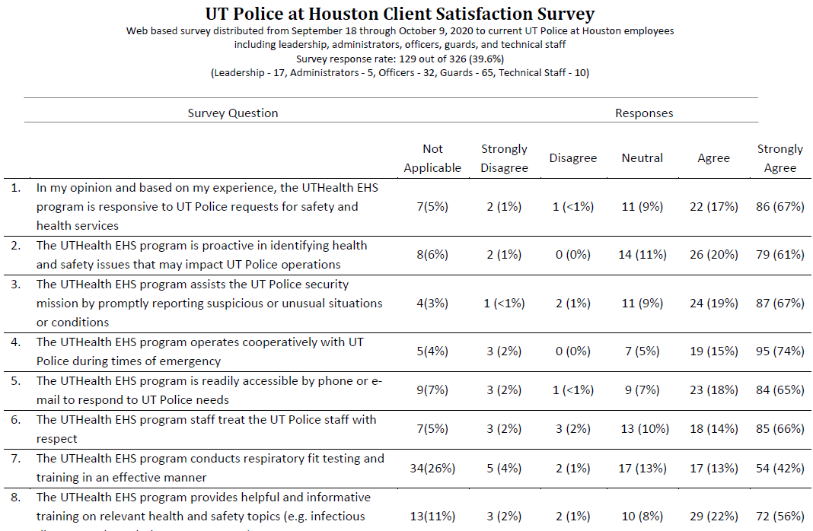
Client Satisfaction Survey (FY20)

Slide 39
Internal Department Staff Satisfaction
Continued support of ongoing academic pursuits – leverage unique linkage with UT SPH for both staff development and research projects that benefit the institution
Weekly continuing education sessions on a wide variety of topics – conducted continuously via virtual format during COVID-19
“Safety Geek of the Week” staff recognition award for superior service delivery
Participation in the delivery of UT SPH continuing education course offerings
Participation in various UT SPH academic courses
Adjunct academic appointments in UT SPH EOHS department for doctorally-prepared staff (n=4)
Participation on several health and safety related grants through UT SPH
Membership, participation in professional organizations
Annual conduct of “SHERM Mentoring Day” where any interested staff member can meet with the VP SHERM to discuss professional development plans and seek advice, suggestions

Slide 40
FY21 Planned Actions – Client Satisfaction
External Clients
  Continue with “customer service” approach to operations
  Collect data for meaningful benchmarking to compare safety program staffing, resourcing, and outcomes
  Interface with CLAMC will be focus for FY21 survey
Internal Clients (departmental staff)
  Continue with routine professional development seminars
    Special focus on emerging issues: safety culture, insider threats, change management, technology in safety (digital safety), total worker health, cultural intelligence, communications, establishing relationships
  Continue with involvement in training courses and outreach activities – continued focus on cross training
  Continue mentoring sessions on academic activities
  Continue 360º evaluations on supervisors to garner feedback from staff

Slide 41
Institutional Safety Service KPI Caveats
Important to remember what isn’t effectively captured by these metrics:
  Increasing complexity of research projects supported
  Increased collaborations and associated challenges
  Increased complexity of regulatory environment
  Impacts of construction – both navigation and reviews
  The pain, suffering, apprehension associated with any injury – every dot on the graph is a person
  The things that didn’t happen

Slide 42
SHERM Contribution to the Community Service Institutional Mission
Safety, insurance, and occupational health support to UT Physicians clinical operations
Staff membership on local safety committees:
Institutional Biosafety Committees (Rice University; University of Houston – Downtown )
Radiation Safety Committees (Memorial Hermann Hospital)
Delivery of professional continuing education courses through UT SPH
Participation in the leadership and management of professional associations by SHERM staff members
  American Biological Safety Association – International
    Inclusive of peer reviewed journal (Applied Biosafety) Editorial Board
  Southern Biosafety Association (local affiliate of ABSA - International)
  State of Texas Chapter of the Health Physics Society
  American Academy of Health Physics
Outreach education through invited lectures provided to local and national professional organizations
Provision of subject matter expert interviews on safety-related topics to local and national media

Slide 43
SHERM Contribution to the Teaching
Institutional Mission
UT SPH academic instruction, student advising
  Several SHERM employees serve in adjunct faculty positions at SPH
Guest lectures at other UTHealth schools (UT MS and GSBS) and other area institutions (TAMU, TWU, TSU, UHCL, UHD)
Host student internships, practica. Advising for UT MS Scholarly Concentration students
Continuing education courses through UT SPH
Outreach education through courses with professional organizations (HPS, ABSA, CSHEMA, Eagleson Institute)

Slide 44
SHERM Contribution to the Research Institutional Mission
NIEHS training grant and Ebola supplement (w/Dr. Rios, UT SPH)
NIOSH evaluation of elastomeric respirators in the healthcare setting grant (w/ Dr. Pompeii, Baylor College of Medicine)
Participation in other funded grants:
  NIOSH ERC SWCOEH
  TSU Health Physics Program - $11,000
COVID-19 related research collaborations:
  Dr. Amber Luong – evaluating decontamination methods for N95 respirators
  Dr. Mary (Cindy) Farach Carson – evaluating novel N95 respirator product
  Memorial Hermann Hospital N95 reprocessing center – validation and management
Advising and hosting students for research projects and associated publications:
  Zapata J.R., Stewart J., Kelly K.O., Taylor A.R., Martinez E.I., Amoako K., Gutierrez J.M., Emery R.J., Cheng S.Y., Patlovich S.J., Harvey M.C. A Cyclotron Decommissioning Radiological Assessment Exercise Performed by Student Mentees Underrepresented in the Radiation Safety Profession. Health Physics, in publication July 2020.
  Emery, R.J., Rios, J., Becker, Z.B., Haltiwanger, B., & Patlovich, S.J. Characterization of Work Settings in Which Biosafety Professionals Conduct Operations: Results from the First Survey of the Biosafety Analytics Initiative Survey Series. Applied Biosafety, Volume 25, Number 2, 2020.
  Pompeii L, Benavides E, Pop O, Rojas Y, Emery R, Delclos G, Markham C, Vellani K, Levine N. Workplace violence in outpatient physician clinics: a systematic review. Int. J. Environ. Res. Public Health 2020, 17(18), 6587; https://doi.org/10.3390/ijerph17186587
  Le, AB, Lowe, JJ, Patlovich, SJ, Emery, RJ, Beam, EL, Strain, A, Vasa, A., Schwedhelm, S, Gibbs, SG. Chapter 8: High-Level Containment Care (HLCC) Unit Operations. In T. Cieslak, M. Kortepeter, J. Lawler, C. Kratochvil (Eds.), The University of Nebraska Medical Center Isolation & Quarantine Manual. Lincoln, Nebraska. University of Nebraska Press. 2019: 61- 86.
  Emery RJ. Gaining Support for Security Programs Through Communications and Data. In: Strategic Security Management: A Risk Assessment Guide for Decision Makers, Second Edition. Vallani KW, CRC Press, Boca Raton FL 2019:193 -198.
  Emery RJ, Charlton MA, Brown BJ, Patlovich S. Contemporary industrial hygiene considerations in the health care work setting. In: Patty’s Industrial Hygiene, 7th Edition, in publication 2020.

Slide 45
Summary
Various measures and metrics indicate that SHERM continues to meet its objective of maintaining a safe and healthy working and learning environment in a cost effective manner that doesn’t interfere with operations, while also making active contributions to the institutional missions:
  Injury rates continue to be among the lowest within the UT System
  Despite continued growth in the research enterprise, hazardous waste costs aggressively contained
  Client satisfaction continues to be measurably high
  And while providing these services, SHERM also actively contributes to the teaching, research, and community service missions of the institution
The major area of current institutional growth is in the clinical setting, so SHERM will need to adjust accordingly to support this enterprises
The impending discontinuance of the UTS WCI Resource Allocation Program represents a challenge, especially for the Occupational Health program
A successful safety program is largely “people powered” – the services most valued by clients cannot be automated!
SHERM resource needs will continue to be driven primarily by the square footage to which services are provided (total, lab and clinic square footage) and geographic distribution

Slide 46


